Slide 1
Social protection: overview of progress and challenges
Building Resilience and Assets for Food Security:
Evidence and Implications for Feed the Future
September 29‐30, 2011, Washington, D.C.
Andrew Shepherd, ODI - a.shepherd@odi.org.uk
Notes:
Challenge of this talk for me – sp has become a wide field of action, how to capture it, and focus on today’s critical issues?

Slide 2
Sources
DFID Cash Transfers Evidence paper
CPRC policy guide, and policy briefs
ODI Briefing Papers, Project Briefings, Toolsheet
DFID Social Protection and Growth
FAC Social protection and Growth...

Slide 3
Contents
Poverty and social protection
The definitional debate
Expansion of provision – geography, politics, range of programmes
Impacts
Challenge of low income countries – politics>capacity>finance
Risks: dependence, revenue diversion, growth reduction
Links with agriculture and markets
Tanzania case study: cotton
Ways forward

Slide 4
Poverty and social protection
Extreme poverty has been hard to reduce despite economic growth
Human development emphasis has not been enough
Social protection addresses risk – bridges between economic and social aspects of deprivation
Cash Transfers are very ‘doable’ for neo-liberal states/world order
Exactly what and how much is debated
What alternatives are there? Asset transfers? Value chain engineering?
In fact they are complementary interventions

Slide 5
Assets-markets-protection synergies
Escaping poverty is ‘saw-toothed’ (PTO)
Building assets and capabilities are key to escaping poverty
Market returns (to labour, to products and services) need to be decent
Protecting gains are critical to falling back into poverty
Sustained escapes require all three: SP is not a magic bullet!
Balancing protection, prevention, & promotion
BRAC TUP classic example
Need many more!
Sections 4 & 6 of Tackling Chronic Poverty: Key messages for policy makers (CPRC, 2011 www.chronicpoverty.org )
Notes:
1st two bullets are the components of PPG, the outcomes/aspects of growth which make it pro-poor.

Slide 6
Notes:
Improvements gradual, often with set backs; impoverishment may be rapid and dramatic
Comparative study in progress to see whether patterns are similar elsewhere (eg Tanzania)

Slide 7
Social protection definitions mature?
Scope
It’s broad, but not the same as poverty reduction
Objective
Increased security as a part of development and transformation, not just risk and vulnerability
Regional diversity
Instruments
Social assistance (cash transfers)
Risk insurance
Food assistance
Asset transfers for resilience

Slide 8
Expansion of provision – geography
Dramatic MIC expansion – up to 1 billion people covered
From MICs to LICs: but with some exceptions (Ethiopia) LICs are far behind
pilots
From LA and Asia to Africa

Slide 9
Expansion of provision – politics and purpose
From the margins to the mainstream development policy
From vulnerability and risk to chronic poverty and back
Eg crisis integration of risk insurance into social assistance
Prevention and protection to promotion and transformation
Deepening of social democracy (LA)
Importance of M & E
Social protection and the social contract
Acknowledgement of enhanced global risks
Increased G8, World Bank commitments
Notes:
Do you remember the SRM?

Slide 10
Expansion of provision – range of programmes
Competitive models and histories
LA: CCTs
S Africa: pension, child and disability grants
S Asia: public works, but also wide variety of allowances and grants
Universal: emergency relief
Innovative approaches:
grants to the poorest households
Insurance (health; micro-finance; weather-indexed)
Notes:
LA: CT programmes tackle underlying causes of future poverty via health, education and child labour
SSA: CTs address life cycle risks (age, orphanhood), chronic poverty and vulnerability
SA: support for social transformation including women’s empowerment OR [me]: support vulnerable workers and malfunctioning labour markets
Look at how politics shapes sp trajectories
Insurance may sound attractive – especially to promote investment and growth in incomes, but insurance markets are so ill developed that cash transfers are likely to play a considerable role.

Slide 11
Range of impacts
Widespread awareness of value of robust evaluation
S/T: reduce poverty (gap), hunger/malnutrition, access to services
M/T: positive effects on livelihood strategies eg asset loss avoidance
L/T: interrupt inter-generational transmission of poverty, via education
Questions remain on effects on inclusive growth, women’s empowerment, reducing/mitigating climate risk, facilitating social cohesion, peace building...
Promoting women’s empowerment/gender equality = secondary objective
Targeting women not enough: adapt programmes to their interests (eg PSNP replacing waged labour with cash support for pregnant and nursing mothers)
Notes:
See useful summary of evidence and strength of it, on p 47.
Strong evidence for s/t and m/t, less so for l/t (becuase time has not elapsed sufficiently in most programmes, Progresa = exception) and effects on growth etc.
Methods of assessment not standardised so size of impact can be difficult to gauge *eg on nutrition).
Graduation (exiting poverty) – topic of the next presentation.
Evidence on growth still poor (was poor in 2004) – why? Channels include: human capital investment, protecting assets, stimulating local markets, greater financial inclusion, easier job seeking...but the poorest contribute little to GDP, so macro-grwoth effects likely to be small.

Slide 12
Factors influencing impacts
Levels of poverty/deprivation
The higher, the bigger the impact
Duration & size of transfer
Level determines extent of poverty reduction
Coverage and quality of targeting
Widest coverage needed in mass poverty/least capacity LDCs
Age of recipient
Need and presence of complementary services
Health, education, but also financial, skills/business training

Slide 13
Challenge of low income countries – politics>capacity>finance
Affordability
MICs: 0.36 – 1.4% of GDP per scheme
Little information on LIC unit costs: $10-20 per month estimate
2.2-5.7% of GDP (ILO model)
0.2 – 8.7% of GDP (ODI/Unicef model)
SCF minimum to get LA-style impacts: 25-30% of household expenditure
Fiscal space varies eg West Africa:
Low population, oil-rich: can afford large scale transfers but currently allocate small budgets to social expenditure and lack institutional capacity
Higher social sector expenditure, but close to IMF limits: implies growth driven increase in tax, and re-allocation
Economic benefits also hard to estimate in LICs, and weighting of welfare gains to the poorest will influence the results.

Slide 14
Challenge of low income countries – politics>capacity>finance
Both food security and life cycle risks driving social protection choices
Is there capacity to do both, in an integrated way?
Weak uncoordinated ministries, low level of social sector professions
‘Social floor’ type initiatives too demanding?
Need for smart instruments which achieve several objectives
Capacity to assess options (PTO)
Mass poverty/vulnerability: targeting needed; capacity limits
Means testing & conditions require greater capacity
Regular updating required; independent auditing – transparency essential
Centralised/decentralised models; innovations...
Electronic payment systems, private sector involvement
Involvement of civil society or local government
Capacity of health and education services a major issue
Complementary programmes – rarely adequate
Notes:
Transparency a big issue. Democracy can help – elected representatives questioning flow of funds to beneficiaries.
Complementary programmes – nutrition, mocro-finance, training etc

Slide 15
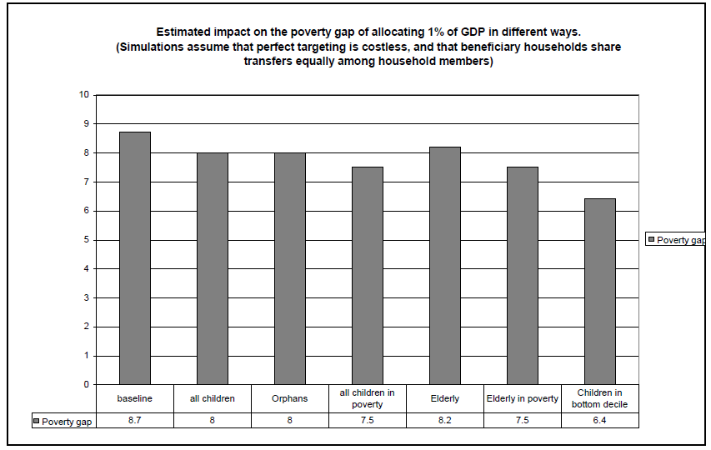
Impact on poverty gap of allocating 1% of GDP
Notes:
Uganda, 2005 UNHS

Slide 16
Challenge of low income countries – politics>capacity>finance
Affordability is a political calculation
Introducing, sustaining large scale schemes not impossible
Nepal and Lesotho pensions; Nepal other schemes
India’s history of provision through multiple schemes since mid 1980s:
No clear link in Asia between pc GDP and level of provision (AsDB SP Index)
Political economy is critical!
Political calculations behind choice of instrument & target groups
Effects of choices on the social contract
Notes:
India: electoral competition may not deliver quality schemes

Slide 17
Politics cont’d
“Electoral politics important in LA and S Asia, not in Africa” ?
Dominant political parties and ‘executive champions’ often key to introduction
but same electoral dynamics: eg 5 million pensioner votes in Tanzania moving to 2 party competition
Crises create political space
Civil society actors pushed, post 1997-8 Asian crisis
South-south learning
Coalitions of support evolve, making sustainability easier than introduction

Slide 18
Risks: dependence
Weak evidence base for dependency in the south
Anecdote, and exposure to northern pre-occupations
Amounts small – don’t discourage job seeking or enterprise, often time bound (CCT, pension)
Children the major beneficiaries
Evidence is of transfers supporting enterprise, job seeking...enhances agency
However: this is a serious concern, needs addressing
CPRC Policy Brief 22 – Social Assistance and the Dependency Syndrome, January 2011
Notes:
There are still many sceptics around. Let’s look at some of the arguments. Dependency, revenue diversion, growth reduction, donor influence

Slide 19
Risks: revenue diversion
In fiscally constrained countries, expenditure targets cannot all be met
Where fiscal space is genuinely limited diversion from health, education, infrastructure, agriculture or other worthwhile expenditure is a serious risk
Political prioritisation is inevitable
‘consumption expenditure’ may not be a priority
Explains absence of domestic financing plans in some LICs
Political priority where national stability or retaining power is at stake (eg Nepal, Kenya)
‘deserving poor’ – eg constrained labour availability
Setting expenditure targets in a silo is not good policy making
ODI Project Briefing 31 (2009) 30 (2010) & 55 (2011)

Slide 20
Risks: growth reduction
Is this a real risk? Macro? Micro?
Macro:
No clear results from growth-social expenditure cross country regressions
Reduced labour supply from children and elderly compensated b y increased adult labour supply
Expenditure choices for fiscally constrained states but social expenditure benefits growth in long term via human capital investments
Addressing inequality now is less costly than addressing it later
Micro:
Strengthens micro-level outcomes:
Regular, reliable transfers lift credit constraints, savings increase
Greater household security leads to higher investment
Channelling transfers to women improves resource allocation (eg to children)
Manage risk by ensuring protection contributes to asset building and that market functioning improves too

Slide 21
Risk: donor influence
Heavy reliance on donor funding: programme design influenced by donor priorities
Lobbies for particular groups (mandated NGOs, Unicef)
Eg OVC focus of PEPFAR & Global Fund supported transfer programmes
Programme sustainability threat
If donors tire of social protection
If a country falls out of favour
Most sustained programmes have been state funded, small scale to start with
Can donors avoid trying to take control?
Startup costs are major, though...
Notes:
Eg powerful pension lobby combines with clear electoral logic

Slide 22
Links with agriculture and markets
Agriculture a core part of the risk environment
Weather and markets
Agriculture policy rarely put risk reduction first
Exceptions: irrigation investments, sustainable agriculture approaches, pest/drought/flood resistant seeds
Calls for integration of agriculture and social protection policies
Need to search for practical ways forward, especially given capacity limits

Slide 23
Tanzania contract farming case study: cotton, assets and protection
Cotton creates stronger upward mobility dynamic in drought prone NW Tanzania than elsewhere
Contract farming expanding the possibilities especially for poorer households
Acquisition of ox-plough & oxen critical to escaping poverty: programme expansion to asset building recommended
Downward mobility is largely due to ill-health and death, and this reduces cotton growing
Cotton revenues could support under-funded Community Health Insurance scheme: programme expansion to protection
Major protection provided is food handouts in 2011 to address widespread food crop failure
Notes:
Example of how a marketing programme could stretch out to covering assets and protection as well

Slide 24
Ways forward: critical issues
Critical to strongly address vulnerability – at the heart of poverty dynamics and chronic poverty
Cash transfers one set of instruments: level of transfer a key issue
Insurance: states have to lead the way
Sectors are reluctant risk proofers: eg agriculture
Innovative asset-market-protection programmes
Support innovative collaborative initiatives
Expenditure target traps: build government capacity to cope with lobbies
Pro-poor politics
Parties critical
Civil society organisations playing a role but...beware lobbies
Donor involvement
Positive but systems need to be tax revenue based
Aid through budget support better than off-budget aid
Beware magic bullet syndrome though
Lots of useful advice in the Social Protection in Africa: a Way Forward document

